Slide 1
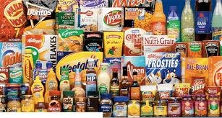
Imperfect Competition
HS201

Slide 2

Introduction
A type of market that does not operate under the rigid rules of perfect competition.
Imperfect competition is a market situation where individual firms have a measure of control over the price of the commodity in an industry.
  a firm that can affect the market price of its output can be classified as an imperfect competitor.
  Normally, imperfect competition arises when an industry's output is supplied only by one, or a relatively small number of firms.
  The "founding father" of the theory of monopolistic competition is Edward Hastings Chamberlin, who wrote a pioneering book on the subject, Theory of Monopolistic Competition (1933).
  Joan Robinson published a book The Economics of Imperfect Competition with a comparable theme of distinguishing perfect from imperfect competition

Slide 3
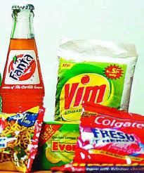
Forms of imperfect competition include
Monopoly,
Oligopoly,
Monopolistic competition,
Monopsony and
Oligopsony.

Slide 4
Sources of market imperfection
Imperfect competition often arises when an industry’s output is supplied by one or a small number of firms.
This may be traced to
the existence of barriers to entry and
the existence of significant differences
or advantages in cost conditions.

Slide 5
Monopoly
A monopoly (from Greek monos / μονος (alone or single) + polein / πωλειν (to sell)) exists when a specific person or enterprise is the only supplier of a particular commodity.
A monopoly is a situation when only one seller of a good or service stay in the market .
In monopoly enterprise is free to set any price it chooses and will usually set the price that yields the largest possible profit.

Slide 6
Features or Characteristics of Monopoly
Single seller
no close substitutes for the product.
No free entry and exit
A complete negation of competition.
Monopolist is a price maker.
The firm and industry are one and same
Monopoly firm faces downward sloping demand curve.
It means he can sell more at lower price and vice versa.
Therefore, elasticity of demand factor is very important for Monopolist

Slide 7
Price and output under a Pure monopoly
A monopolist may take market demand as its own demand curve
The firm is a price maker but it cannot charge a price that the consumers will not bear
A monopolist has market power which is the power to raise price above marginal cost without fear of losing supernormal profits to new entrants to a market
In this sense, price elasticity of demand acts as a constraint on the pricing-power of the monopolist
Assuming that the monopolist aims to maximise profits (where MR=MC), we establish a short run price and output equilibrium as shown in the diagram below

Slide 8
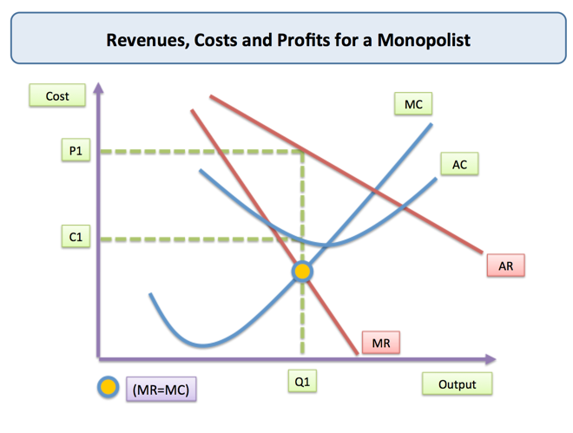
Fig-1

Slide 9
Short-Run Revenues and Costs for the Monopolist
Short-run Costs and Revenue for a Monopolist
The profit-maximizing monopolist employs the same decision rule as the competitive firm ➔ the monopolist produces that quantity where total revenue exceeds total cost by the greatest amount ➔ $12,500 per day when output is 10 units per day. Total revenue is $52,500 and total cost is $40,000
Price Marginal Marginal Average Total
Diamonds (average Total Revenue Total Cost Total Cost Profit or
per day revenue) revenue (MR = Cost ( MC = (ACT = Loss =
(Q) (p) (TR = Q x p) TR / Q) (TC) TC / Q) TC/Q) TR - TC
(1) (2) (3) =(1) x (2) (4) (5) (6) (7) (8)
0 $7,750 0 - $15,000 - - -$15,000
1 7,500 $7,500 $7,500 19,750 4,750 $19,750 -12,250
2 7,250 14,500 7,000 23,500 3,750 11,750 9,000
3 7,000 21,000 6,500 26,500 3,000 8,830 -5,500
4 6,750 27,000 6,000 29,000 2,500 7,750 -2,000
5 6,500 32,500 5,500 31,000 2,000 6,200 1,500
6 6,250 37,500 5,000 32,500 1,500 5,420 5,000
7 6,000 42,000 4,500 33,750 1,250 4,820 8,250
8 5,750 46,000 4,000 35,250 1,500 4,410 10,750
9 5,500 49,500 3,500 37,250 2,000 4,140 12,250
10 5,250 52,500 3,000 40,000 2,750 4,000 12,500
11 5,000 55,000 2,500 43,250 3,250 3,930 11,750
12 4,750 57,000 2,000 48,000 4,750 4,000 9,000
13 4,500 58,500 1,500 54,500 6,500 4,190 4,000
14 4,250 59,500 1,000 64,000 9,500 4,570 -4,500
15 4,000 60,000 500 77,500 13,500 5,170 -7,500
16 3,750 60,000 0 96,000 18,500 6,000 -36,000
17 3,500 59,500 -500 121,000 25,000 7,120 -61,500

Slide 10
Short-Run Revenues and Costs for the Monopolist
Short-run Costs and Revenue for a Monopolist
Applying the marginal rule would imply that the monopolist increases output as long as selling additional diamonds adds more to total revenue than to total cost. Again profit is maximized at $12,500 when output is 10 diamonds per day, per unit costs are $4,000 and the price is $5,250. Exhibit 6 provides a graphical illustration of this process.
Price Marginal Marginal Average Total
Diamonds (average Total Revenue Total Cost Total Cost Profit or
per day revenue) revenue (MR = Cost ( MC = (ACT = Loss =
(Q) (p) (TR = Q x p) TR / Q) (TC) TC / Q) TC/Q) TR - TC
(1) (2) (3) =(1) x (2) (4) (5) (6) (7) (8)
0 $7,750 0 - $15,000 - - -$15,000
1 7,500 $7,500 $7,500 19,750 4,750 $19,750 -12,250
2 7,250 14,500 7,000 23,500 3,750 11,750 9,000
3 7,000 21,000 6,500 26,500 3,000 8,830 -5,500
4 6,750 27,000 6,000 29,000 2,500 7,750 -2,000
5 6,500 32,500 5,500 31,000 2,000 6,200 1,500
6 6,250 37,500 5,000 32,500 1,500 5,420 5,000
7 6,000 42,000 4,500 33,750 1,250 4,820 8,250
8 5,750 46,000 4,000 35,250 1,500 4,410 10,750
9 5,500 49,500 3,500 37,250 2,000 4,140 12,250
10 5,250 52,500 3,000 40,000 2,750 4,000 12,500
11 5,000 55,000 2,500 43,250 3,250 3,930 11,750
12 4,750 57,000 2,000 48,000 4,750 4,000 9,000
13 4,500 58,500 1,500 54,500 6,500 4,190 4,000
14 4,250 59,500 1,000 64,000 9,500 4,570 -4,500
15 4,000 60,000 500 77,500 13,500 5,170 -7,500
16 3,750 60,000 0 96,000 18,500 6,000 -36,000
17 3,500 59,500 -500 121,000 25,000 7,120 -61,500

Slide 11
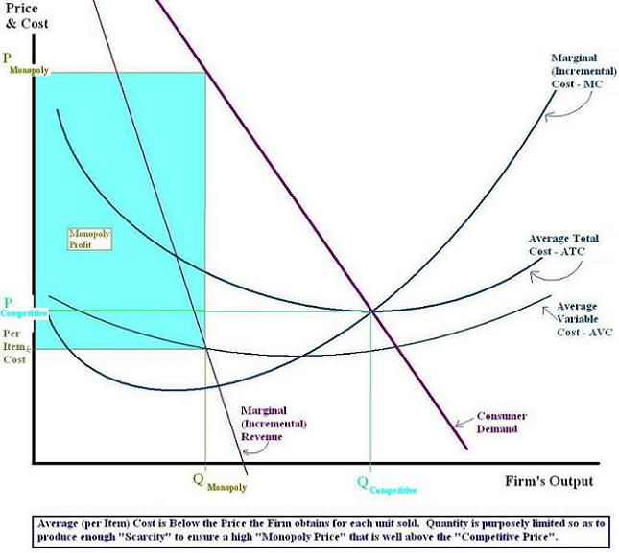
Profit Under Monopoly

Slide 12
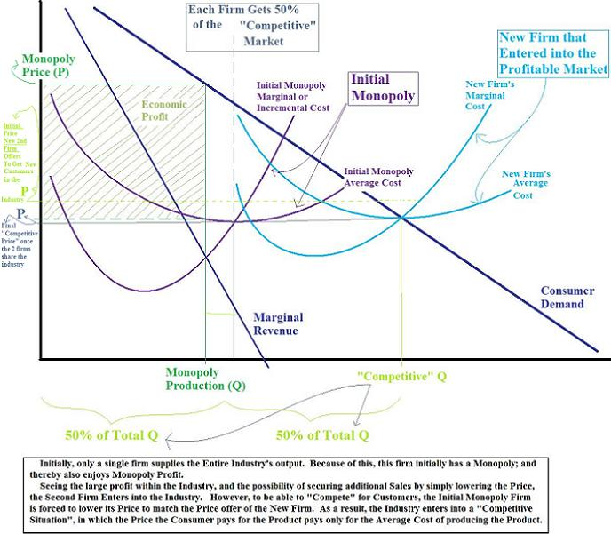
Government intervention in Monopoly

Slide 13
Key Points
  A monopolist typically selects a higher price and lesser quantity than a price-taking company.
  Unlike a PC firms a monopoly has the market all to itself and faces the downward-sloping Market Demand Curve (MDC).
  Through graph one can find a monopoly's price ,output, and profit by examining the demand, MC , and MR curves.

